Slide 1
State DOT Resilience Improvement Plans
Verbatim English resilience definitions and risk scoring evidence from source PDFs
Output generated from downloaded PDFs in C:\Users\xings\Desktop\dot rip

Slide 2
Reading Guide
Definition text is verbatim English from the PDF where a formal definition was found.
Definition box
Uses original English wording. If the source PDF did not contain a formal definition, the slide says so explicitly.
Evidence screenshots
Both definition and risk sections include cropped screenshots from the PDF, with page number and URL in the footer.
Risk scoring box
Summarizes the scoring method in English, then relies on the source screenshot for the original method details.

Slide 3
Definition Index
Verbatim source definitions, rows 1-10.
CA
California
No formal resilience definition found in the downloaded PDF.
CO
Colorado
What is Resilience? Developing CDOT’s Risk and Resilience Program The State of Colorado defines resilience as “the ability of communities to rebound, positively adapt to, or thrive amidst changing conditions or challenges—including human-caused and natural disasters—and to maintain quality of life, healthy growth, durable systems, economic vitality, and conservation of resources for present and future generations.
CT
Connecticut
The ability to anticipate, prepare for, and adapt to changing conditions and withstand, respond to, and recover rapidly from disruptions.
DE
Delaware
resiliency is the ability to anticipate, prepare for, and adapt to changing conditions and withstand, respond to, and recover rapidly from disruptions.
FL
Florida
No formal resilience definition found in the downloaded PDF.
IA
Iowa
INTRODUCTION Defining Resiliency The Iowa DOT defines resiliency as the ability to anticipate, prepare for, and adapt to changing conditions and withstand, respond to, and quickly recover from disruptions.
KY
Kentucky
resilience, defined by the Federal Highway Administration (FHWA) as the ability to anticipate, prepare for, and adapt to changing conditions and withstand, respond to, and recover rapidly from disruptions, is an important component of KYTC’s mission.
MD
Maryland
resilience-focused activities across four main areas of focus: • Planning: Resilience planning activities to assess surface transportation infrastructure vulnerabilities from the impacts of natural hazards.
MI
Michigan
resilience is critical to the ongoing resilience of statewide and community assets, such as housing, emergency management assets, energy, water, and communication infrastructure.
MN
Minnesota
RESILIENCE? There are immediate opportunities for MnDOT and partners to invest in climate resilience projects.

Slide 4
Definition Index
Verbatim source definitions, rows 11-20.
MS
Mississippi
resilience-enhancing projects, thereby reducing the financial burden on state government.
NC
North Carolina
resiliency is “the ability to anticipate, prepare for, and adapt to changing conditions and withstand, respond to, and recover rapidly from disruptions”.
NM
New Mexico
resilience is the ability to avoid, anticipate, absorb, adapt to, and/or rapidly recover from current and future hazards.
OH
Ohio
Resilience is central to ODOT’s mission of providing a transportation system that is safe, accessible, well maintained, and positioned for the future.
OR
Oregon
Resilience is the ability to anticipate, prepare for or adapt to conditions; or withstand, respond to or recover rapidly from system disruptions.
RI
Rhode Island
Resilience is defined by RIDOT as the ability of the Rhode Island transportation system to anticipate, prepare for, and adapt to changing conditions; and withstand, respond to, and recover rapidly from any disruptions.
TX
Texas
Resilience is the ability to support and maintain a multimodal transportation system that can safely move people, goods, and services during adverse conditions, and to be able to anticipate, prepare for, adapt to, withstand, respond to, and recover efficiently from both human and natural disasters and disruptions.
UT
Utah
Resilience is the ability to anticipate, prepare for, or adapt to conditions or withstand, respond to, or recover rapidly from disruptions.
VA
Virginia
resilience is the capability of a transportation project or strategy to anticipate, prepare for, respond to, or recover from significant multi hazard threats with minimum damage and disruption to the transportation network, while preserving and incorporating natural and built infrastructure that helps to mitigate these threats.
VT
Vermont
No formal resilience definition found in the downloaded PDF.

Slide 5
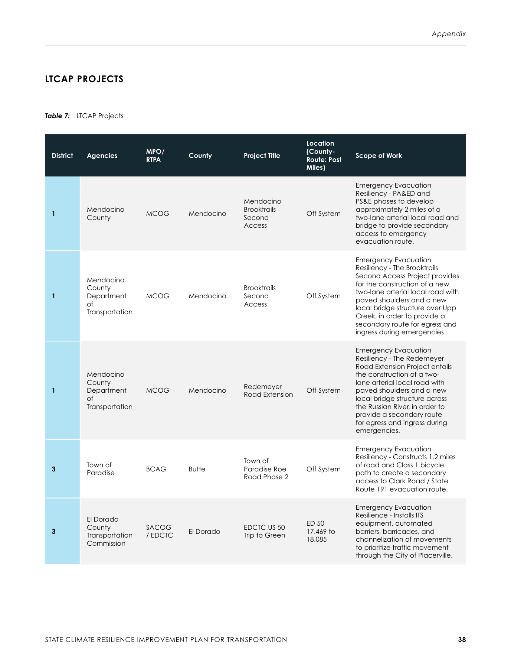
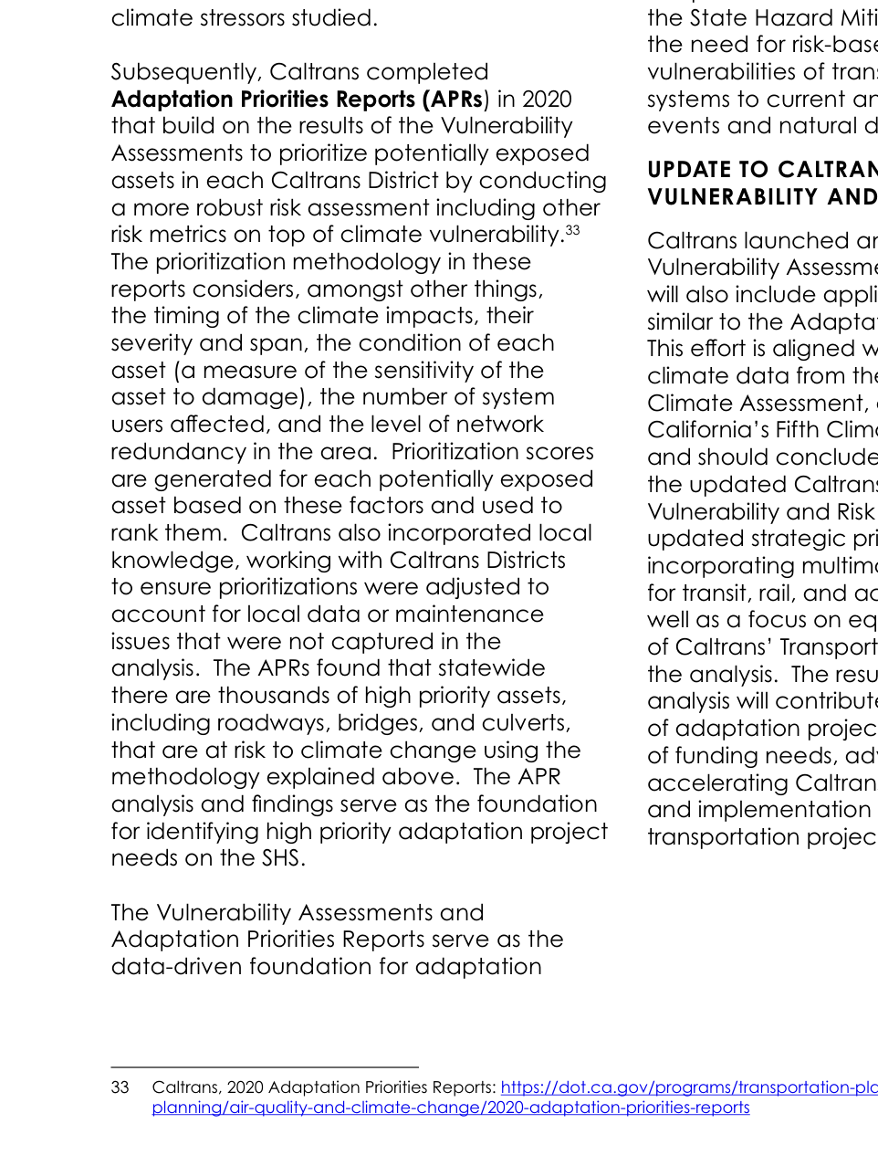
California / Caltrans: original definition and risk scoring
1/20 | CA_Caltrans_SCRIPT_RIP_2023_Amendment1.pdf
Original PDF excerpt: definition
Verbatim resilience definition
No formal resilience definition found in the downloaded PDF.
Definition source page: 48
Original PDF excerpt: risk scoring / assessment
Risk scoring / assessment
score/rating method: consequence/severity, sensitivity, vulnerability
See original excerpt on the right for scoring table, matrix, or assessment language.
Source: CA_Caltrans_SCRIPT_RIP_2023_Amendment1.pdf; definition p.48, risk p.29; URL: https://dot.ca.gov/-/media/dot-media/programs/transportation-planning/documents/office-of-smart-mobility-and-climate-change/2023-script-amendment-1-with-letters-a11y.pdf

Slide 6
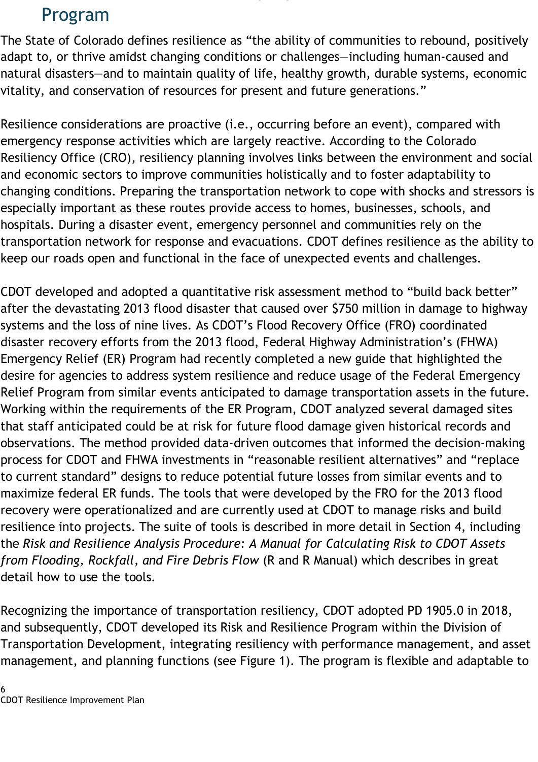
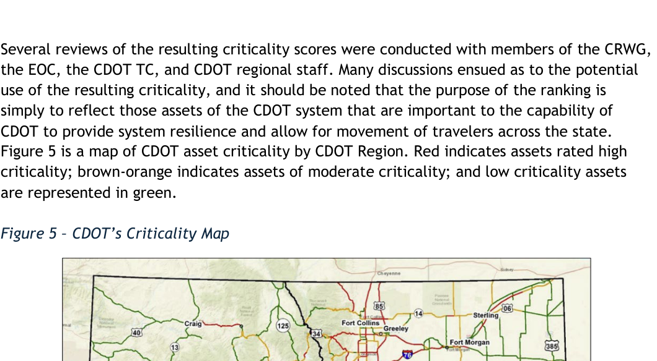
Colorado / CDOT: original definition and risk scoring
2/20 | CO_CDOT_Resilience_Improvement_Plan.pdf
Original PDF excerpt: definition
Verbatim resilience definition
What is Resilience? Developing CDOT’s Risk and Resilience Program The State of Colorado defines resilience as “the ability of communities to rebound, positively adapt to, or thrive amidst changing conditions or challenges—including human-caused and natural disasters—and to maintain quality of life, healthy growth, durable systems, economic vitality, and conservation of resources for present and future generations.
Definition source page: 6
Original PDF excerpt: risk scoring / assessment
Risk scoring / assessment
score/rating method: criticality
See original excerpt on the right for scoring table, matrix, or assessment language.
Source: CO_CDOT_Resilience_Improvement_Plan.pdf; definition p.6, risk p.25; URL: https://www.tam-portal.com/wp-content/uploads/sites/12/2025/07/cdot-resilience-improvement-plan-final-02-10-2025.pdf

Slide 7
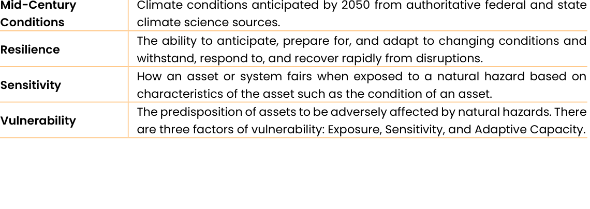
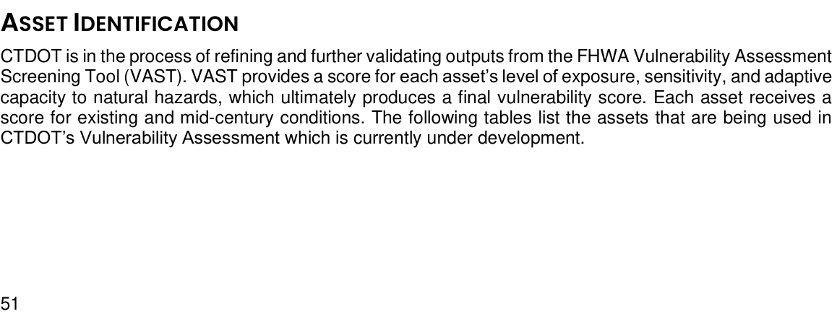
Connecticut / CTDOT: original definition and risk scoring
3/20 | CT_CTDOT_Resilience_Improvement_Plan.pdf
Original PDF excerpt: definition
Verbatim resilience definition
The ability to anticipate, prepare for, and adapt to changing conditions and withstand, respond to, and recover rapidly from disruptions.
Definition source page: 6
Original PDF excerpt: risk scoring / assessment
Risk scoring / assessment
score/rating method: exposure, sensitivity, adaptive capacity, vulnerability
See original excerpt on the right for scoring table, matrix, or assessment language.
Source: CT_CTDOT_Resilience_Improvement_Plan.pdf; definition p.6, risk p.59; URL: https://portal.ct.gov/dot/-/media/dot/programs/rip/ctdot-resilience-improvement-plan.pdf

Slide 8
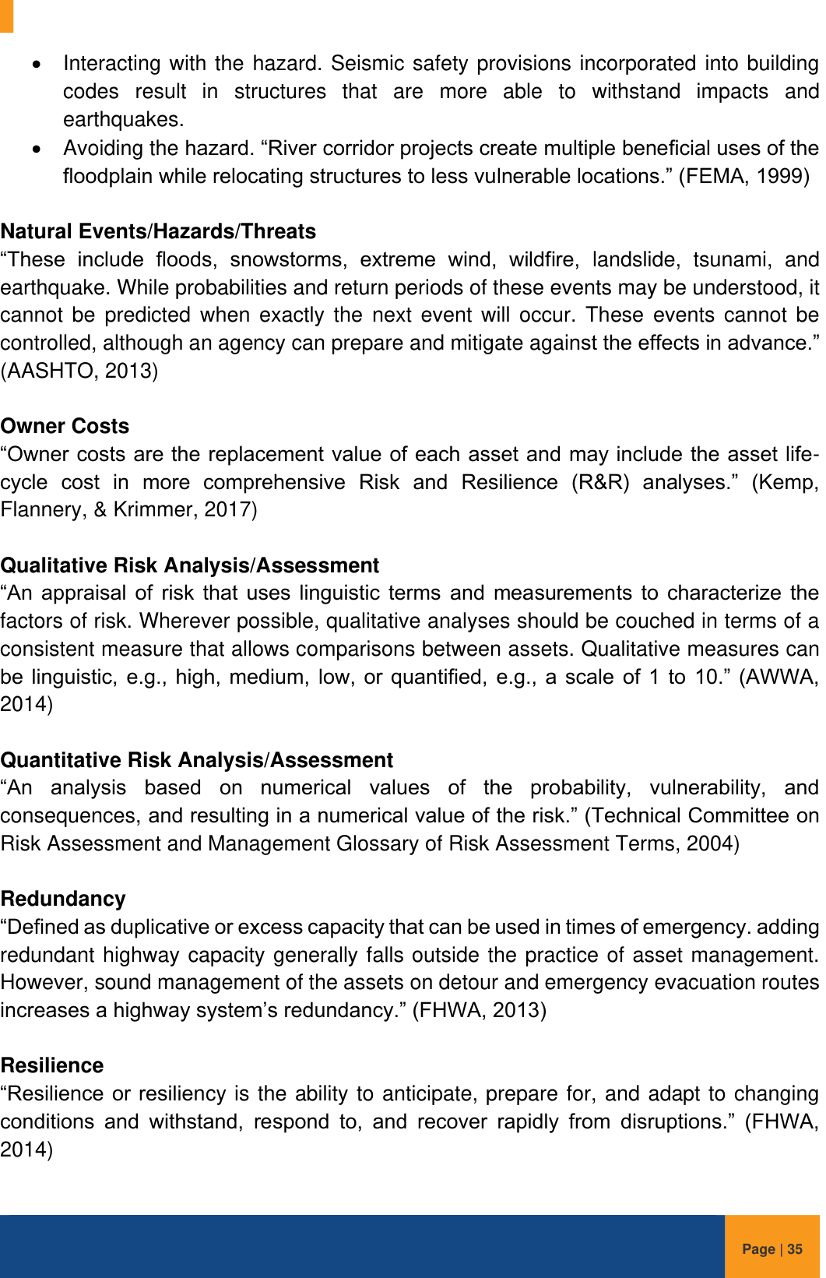
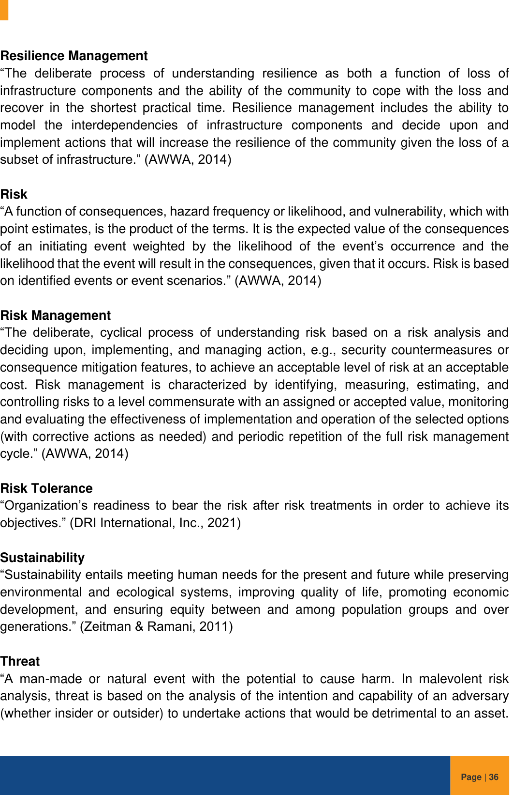
Delaware / DelDOT: original definition and risk scoring
4/20 | DE_DelDOT_DRIP_FHWA_Approved_2023.pdf
Original PDF excerpt: definition
Verbatim resilience definition
resiliency is the ability to anticipate, prepare for, and adapt to changing conditions and withstand, respond to, and recover rapidly from disruptions.
Definition source page: 40
Original PDF excerpt: risk scoring / assessment
Risk scoring / assessment
risk-based vulnerability assessment: likelihood, consequence/severity, vulnerability
See original excerpt on the right for scoring table, matrix, or assessment language.
Source: DE_DelDOT_DRIP_FHWA_Approved_2023.pdf; definition p.40, risk p.41; URL: https://www.erm-portal.com/wp-content/uploads/sites/15/wpforms/7075-e1233af55e4247e91b2324b29a729bf8/DelDOT-DRIP-FHWA-Approved-09.07.23-a120b9904b5093d01726203eead2d3af.pdf

Slide 9
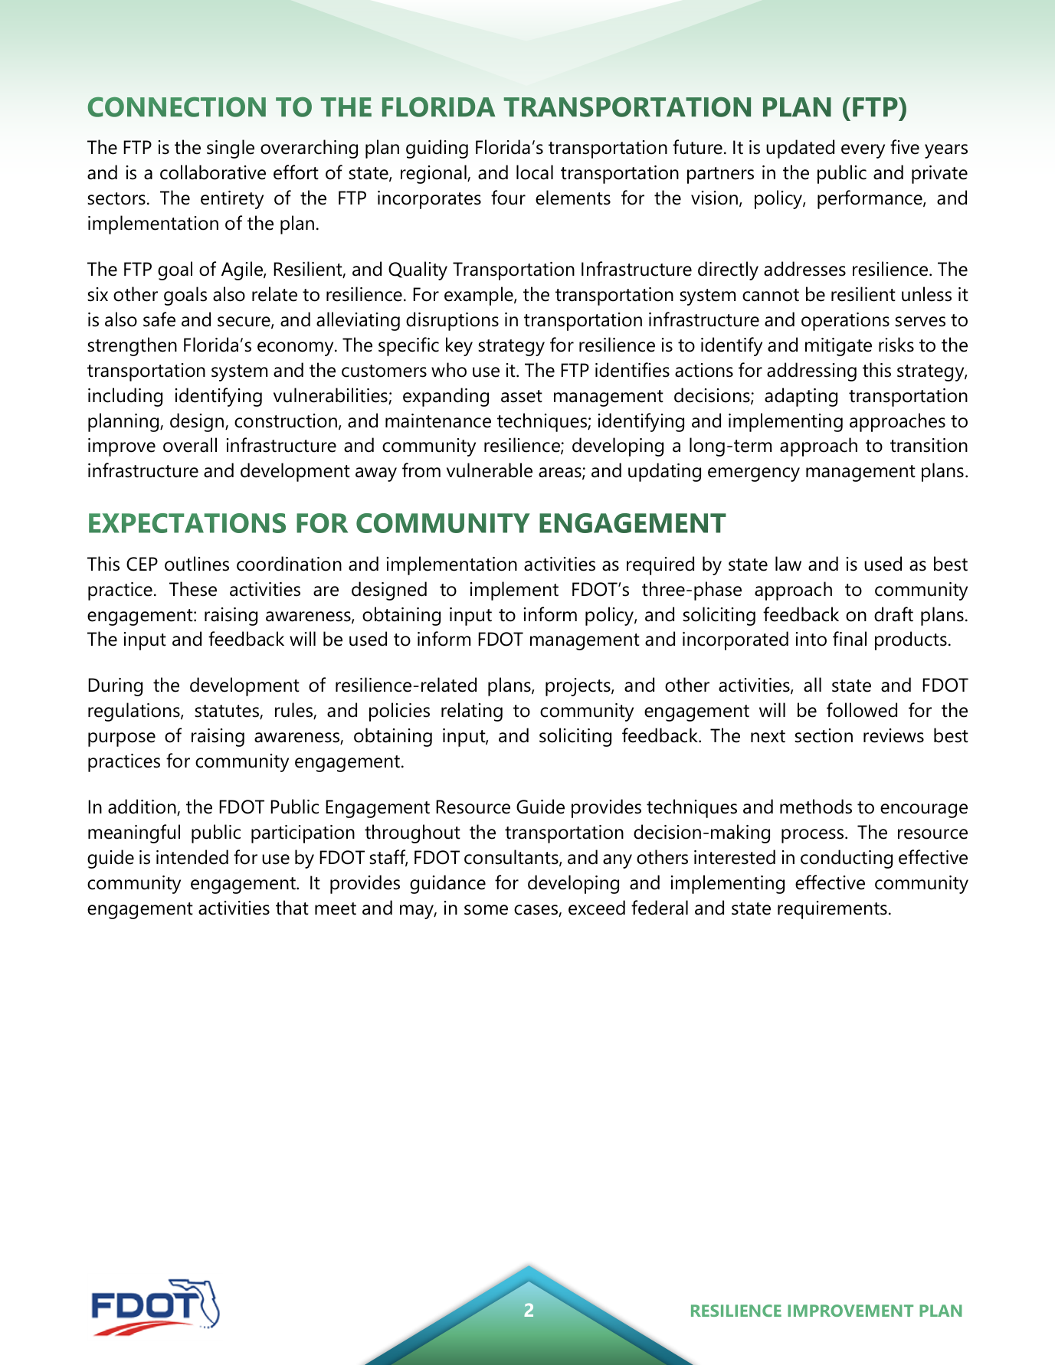
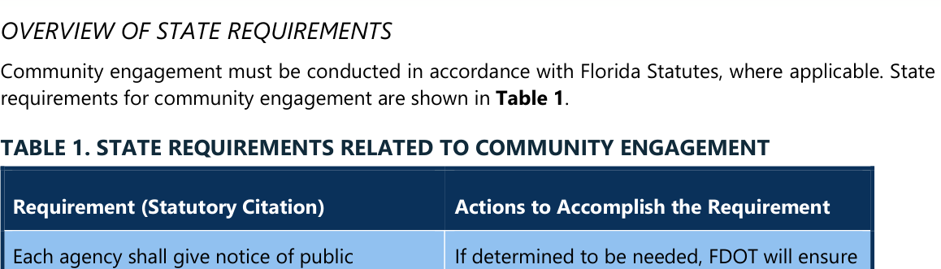
Florida / FDOT: original definition and risk scoring
5/20 | FL_FDOT_RIP_CEP_Final.pdf
Original PDF excerpt: definition
Verbatim resilience definition
No formal resilience definition found in the downloaded PDF.
Definition source page: 2
Original PDF excerpt: risk scoring / assessment
Risk scoring / assessment
risk-based vulnerability assessment: no explicit scoring formula found in the located excerpt
See original excerpt on the right for scoring table, matrix, or assessment language.
Source: FL_FDOT_RIP_CEP_Final.pdf; definition p.2, risk p.3; URL: https://fdotwww.blob.core.windows.net/sitefinity/docs/default-source/planning/resilience-(opp)/resilience-improvement-plan/rip_cep_final.pdf?sfvrsn=b8098df8_1

Slide 10
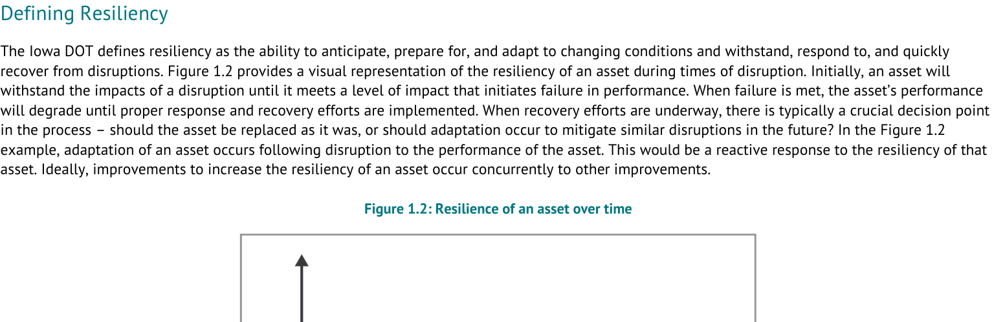
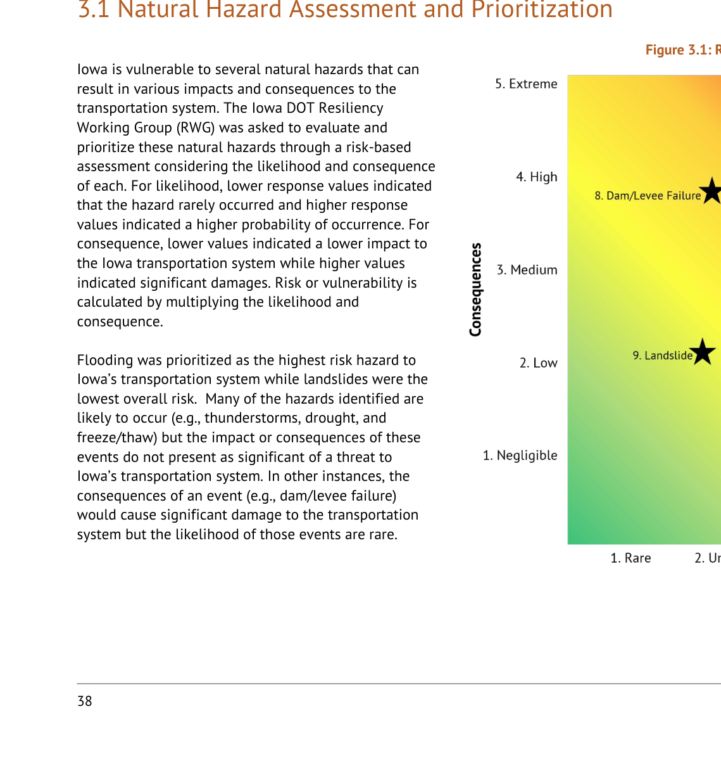
Iowa / Iowa DOT: original definition and risk scoring
6/20 | IA_IowaDOT_2024_Resilience_Improvement_Plan.pdf
Original PDF excerpt: definition
Verbatim resilience definition
INTRODUCTION Defining Resiliency The Iowa DOT defines resiliency as the ability to anticipate, prepare for, and adapt to changing conditions and withstand, respond to, and quickly recover from disruptions.
Definition source page: 8
Original PDF excerpt: risk scoring / assessment
Risk scoring / assessment
risk-based vulnerability assessment: likelihood, probability, consequence/severity, vulnerability
See original excerpt on the right for scoring table, matrix, or assessment language.
Source: IA_IowaDOT_2024_Resilience_Improvement_Plan.pdf; definition p.8, risk p.38; URL: https://iowadot.gov/media/2596/download?inline=

Slide 11
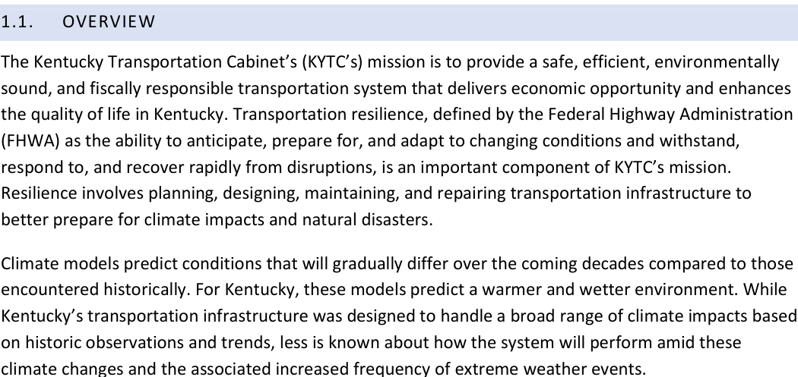
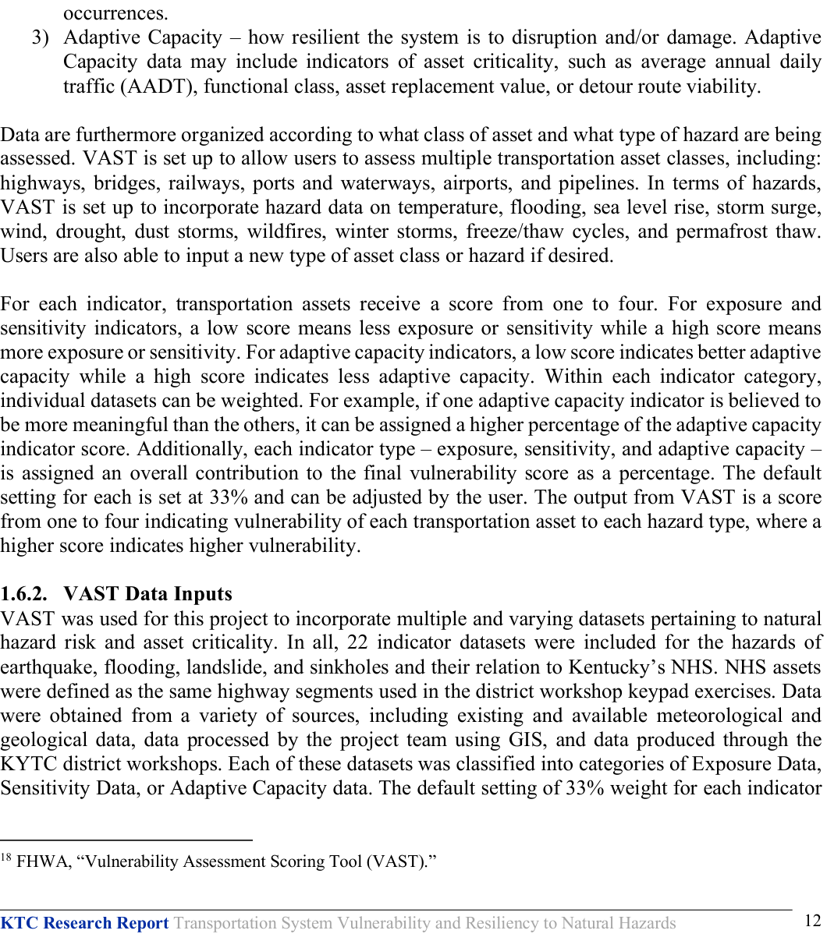
Kentucky / KYTC: original definition and risk scoring
7/20 | KY_KYTC_Resiliency_Improvement_Plan_2023.pdf
Original PDF excerpt: definition
Verbatim resilience definition
resilience, defined by the Federal Highway Administration (FHWA) as the ability to anticipate, prepare for, and adapt to changing conditions and withstand, respond to, and recover rapidly from disruptions, is an important component of KYTC’s mission.
Definition source page: 3
Original PDF excerpt: risk scoring / assessment
Risk scoring / assessment
score/rating method: exposure, sensitivity, adaptive capacity, criticality, vulnerability
See original excerpt on the right for scoring table, matrix, or assessment language.
Source: KY_KYTC_Resiliency_Improvement_Plan_2023.pdf; definition p.3, risk p.53; URL: https://www.erm-portal.com/wp-content/uploads/sites/15/2024/08/KYTC-Resiliency-Improvement-Plan-202306-bfe355f2a24c9e7591e4146a5b7226e1.pdf

Slide 12
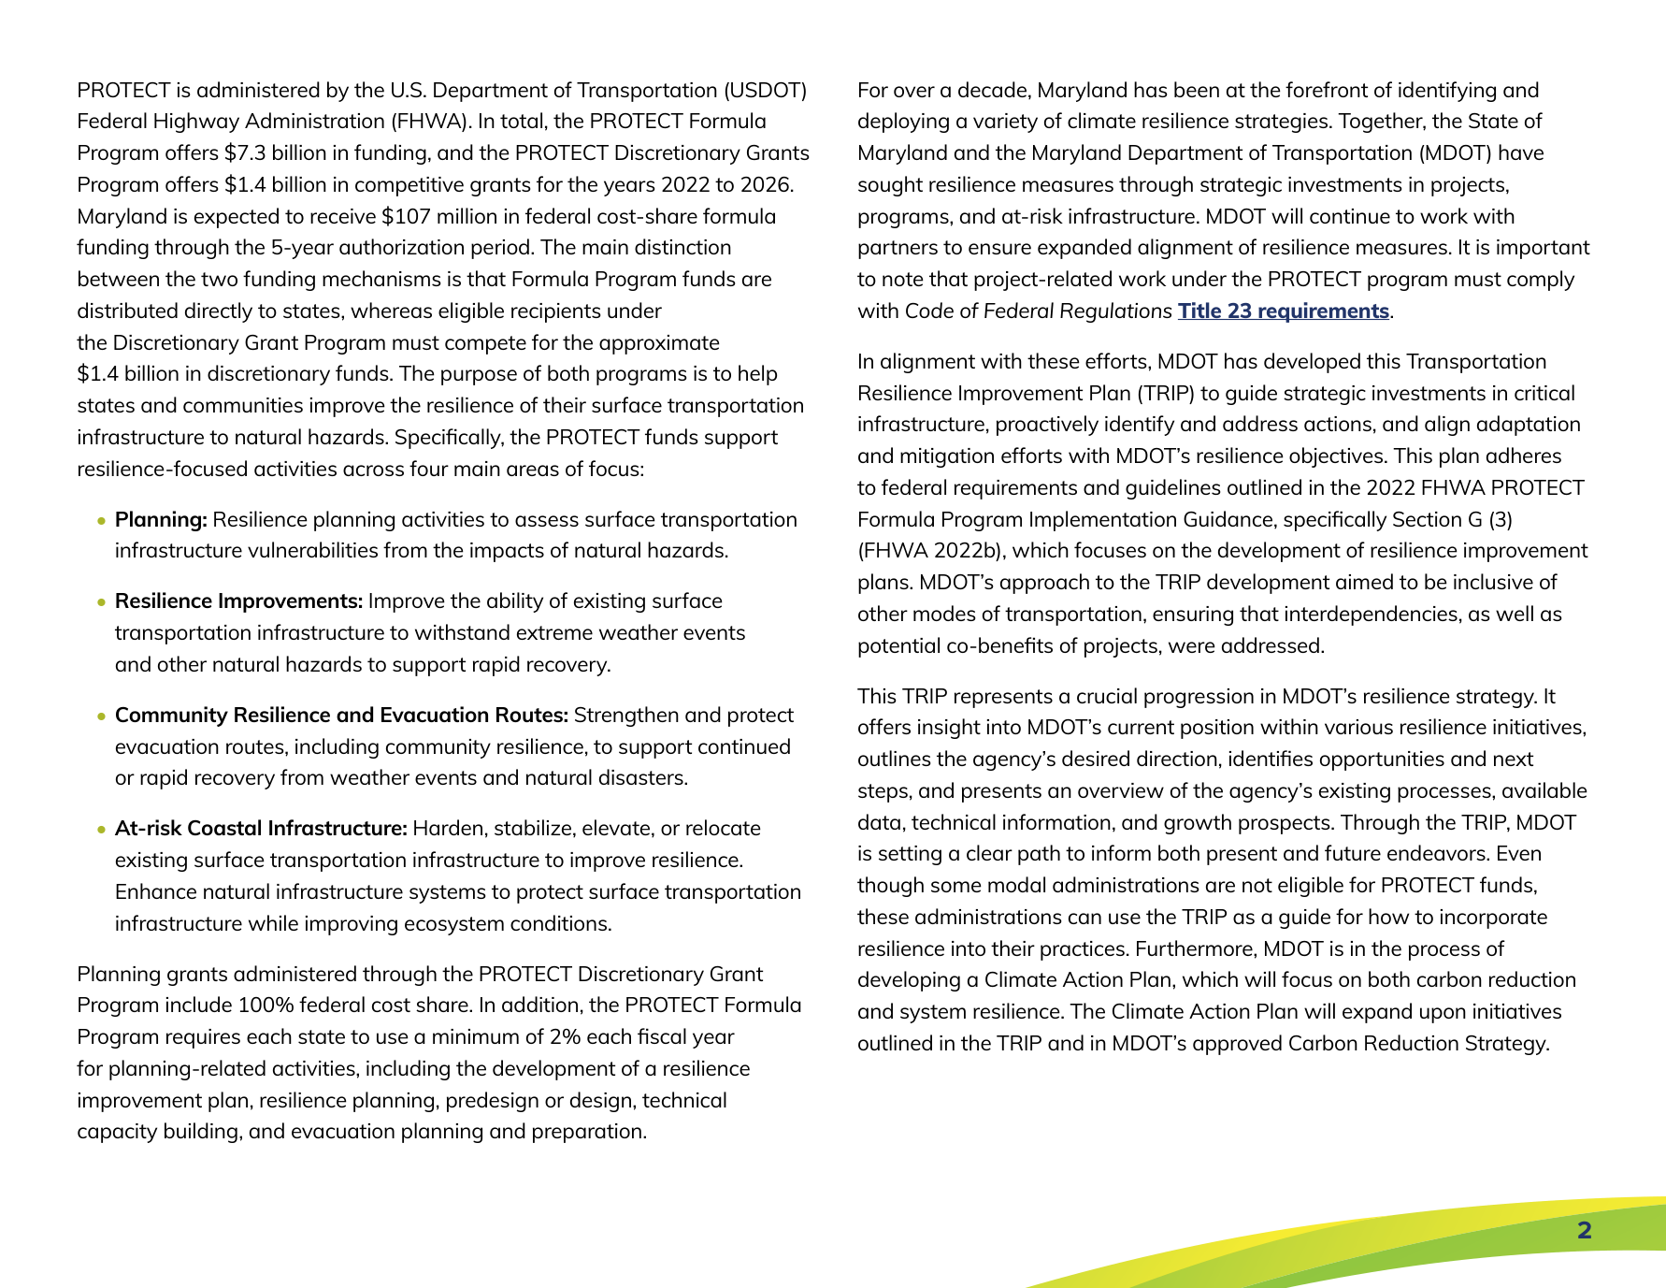
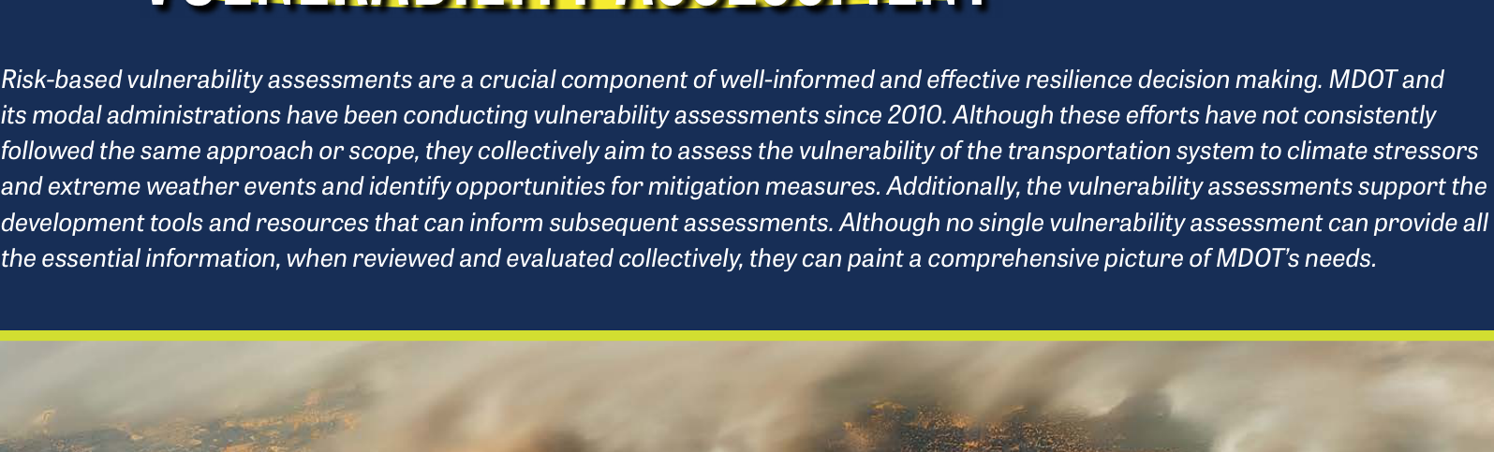
Maryland / MDOT: original definition and risk scoring
8/20 | MD_MDOT_Transportation_Resilience_Improvement_Plan_2024.pdf
Original PDF excerpt: definition
Verbatim resilience definition
resilience-focused activities across four main areas of focus: • Planning: Resilience planning activities to assess surface transportation infrastructure vulnerabilities from the impacts of natural hazards.
Definition source page: 4
Original PDF excerpt: risk scoring / assessment
Risk scoring / assessment
risk-based vulnerability assessment: vulnerability
See original excerpt on the right for scoring table, matrix, or assessment language.
Source: MD_MDOT_Transportation_Resilience_Improvement_Plan_2024.pdf; definition p.4, risk p.27; URL: https://www.mdot.maryland.gov/OPCP/MDOT_TRIP_Report_2024_Final.pdf

Slide 13
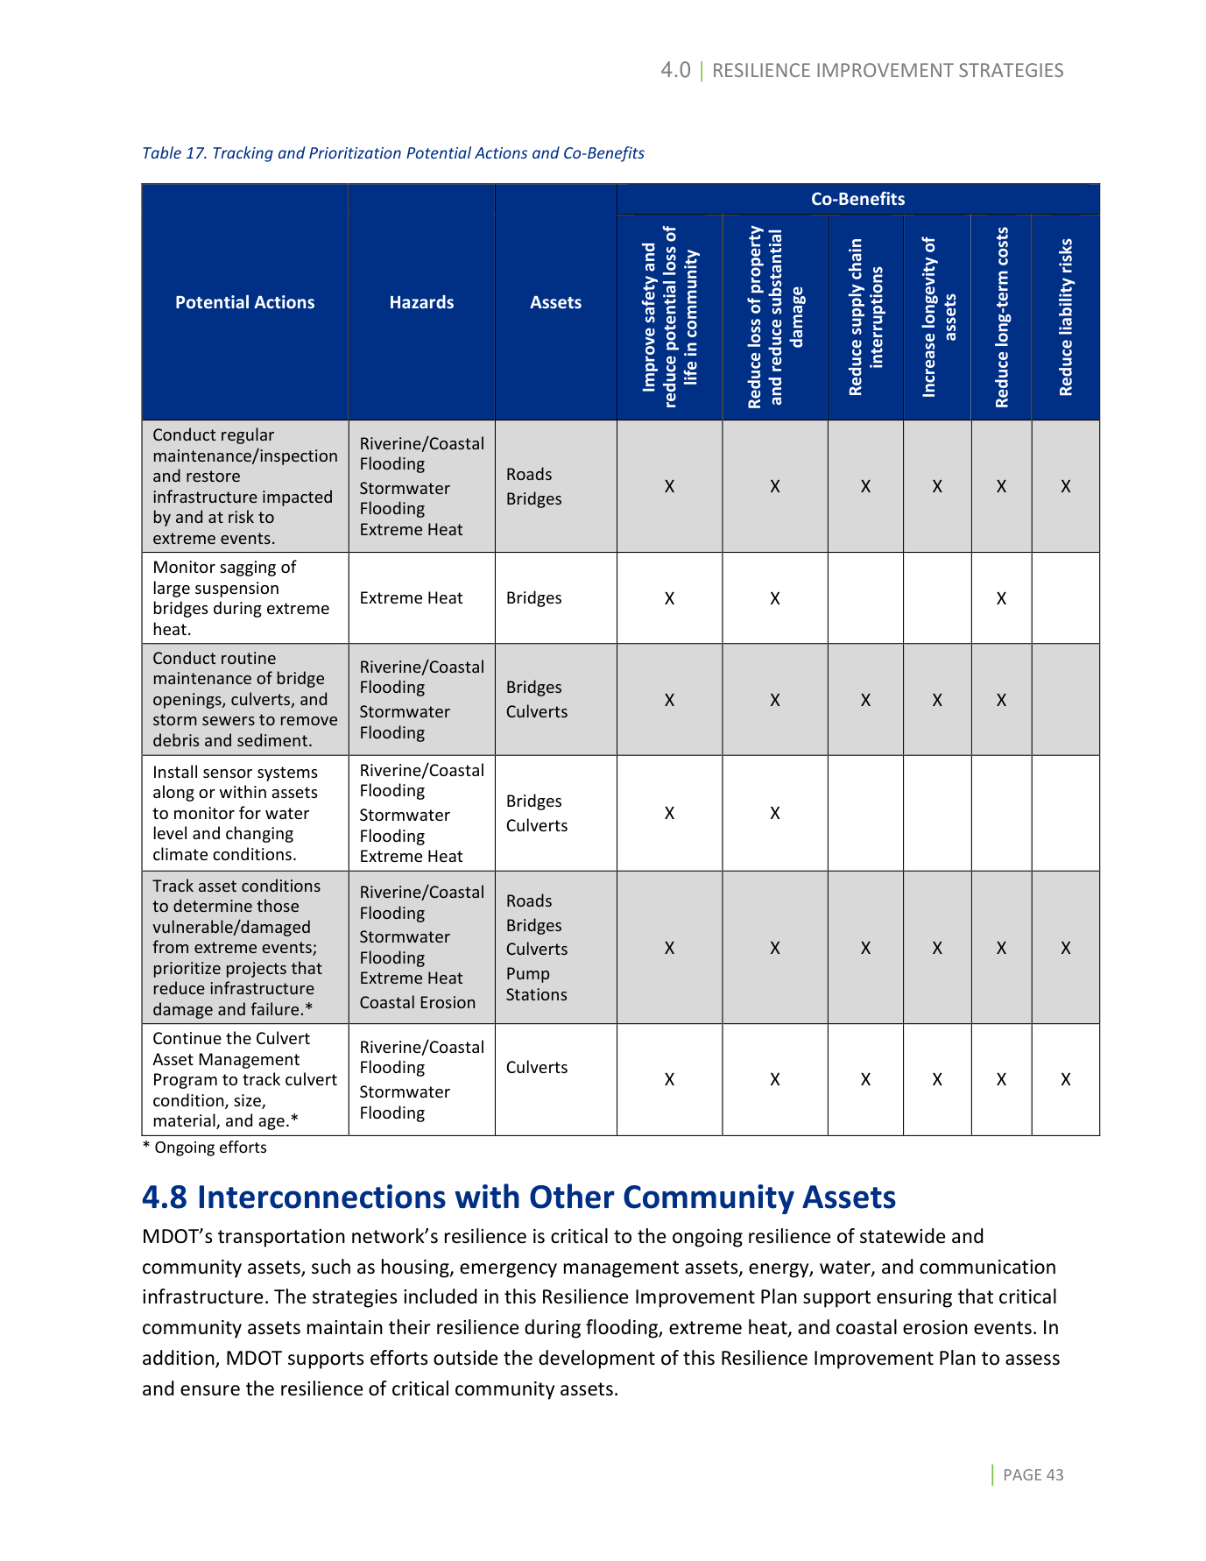
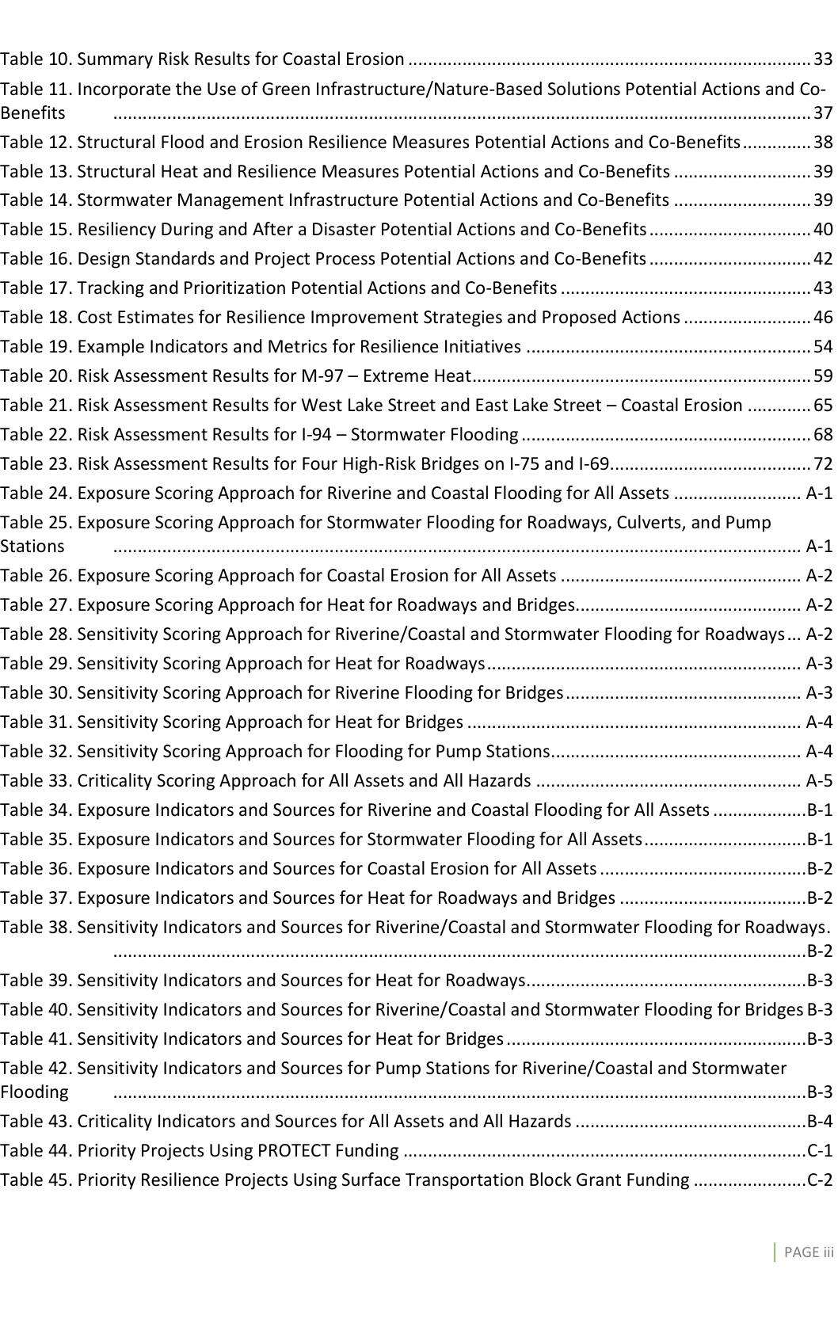
Michigan / MDOT: original definition and risk scoring
9/20 | MI_MDOT_Resilience_Improvement_Plan_2024.pdf
Original PDF excerpt: definition
Verbatim resilience definition
resilience is critical to the ongoing resilience of statewide and community assets, such as housing, emergency management assets, energy, water, and communication infrastructure.
Definition source page: 45
Original PDF excerpt: risk scoring / assessment
Risk scoring / assessment
score/rating method: exposure, sensitivity, criticality
See original excerpt on the right for scoring table, matrix, or assessment language.
Source: MI_MDOT_Resilience_Improvement_Plan_2024.pdf; definition p.45, risk p.5; URL: https://www.michigan.gov/mdot/-/media/Project/Websites/MDOT/Programs/Planning/Resilience-Improvement-Plan/Plan.pdf

Slide 14
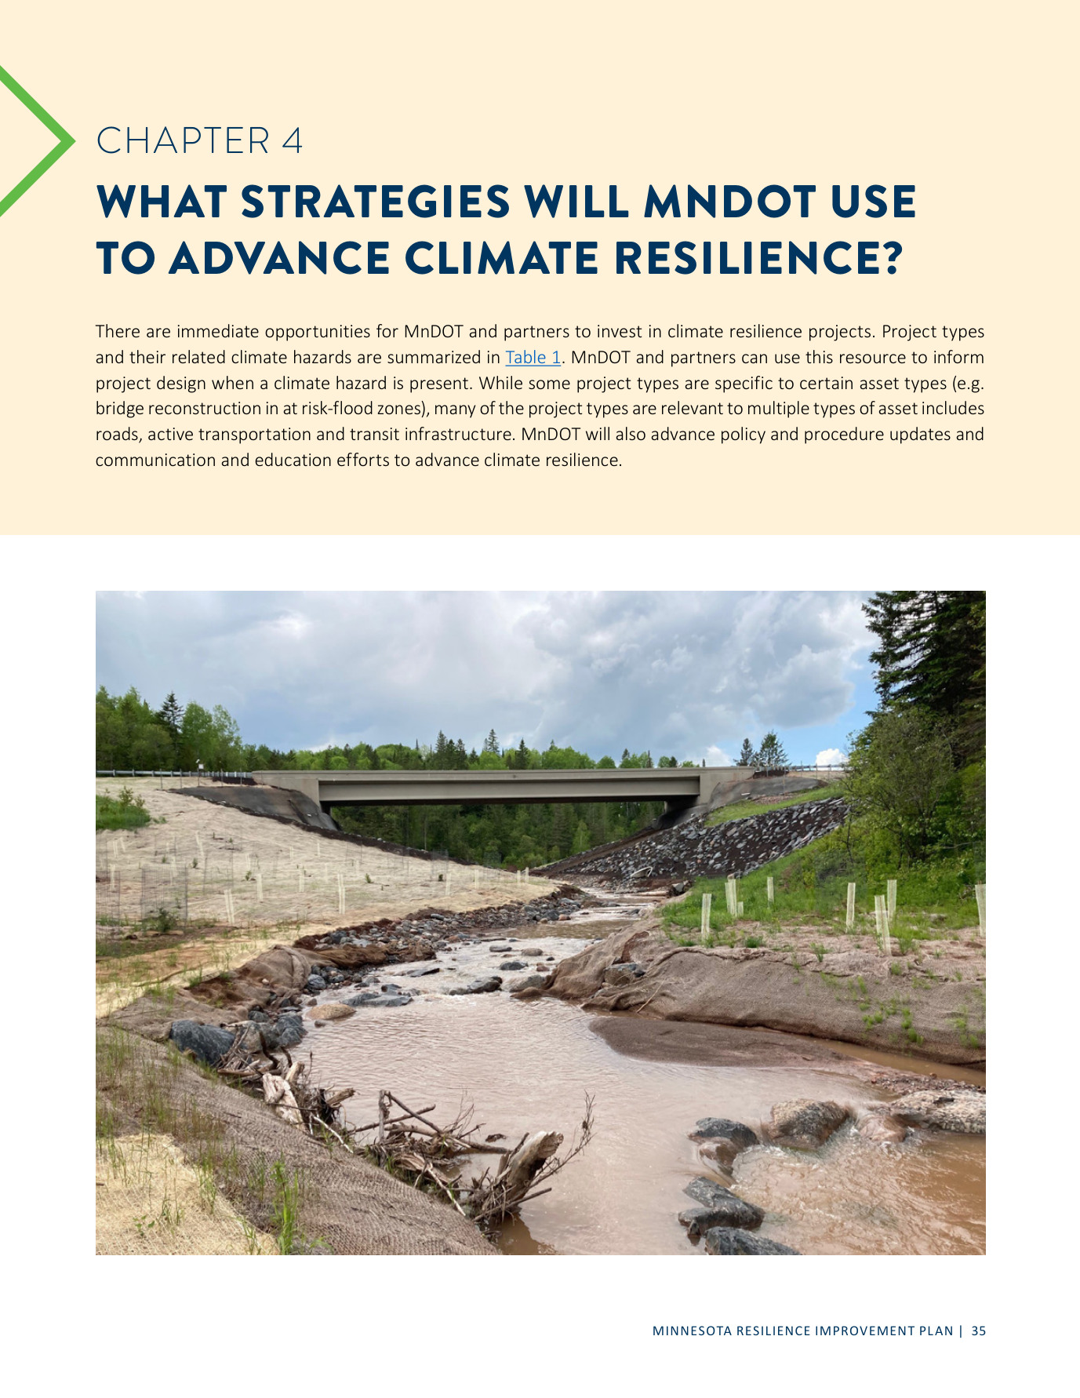
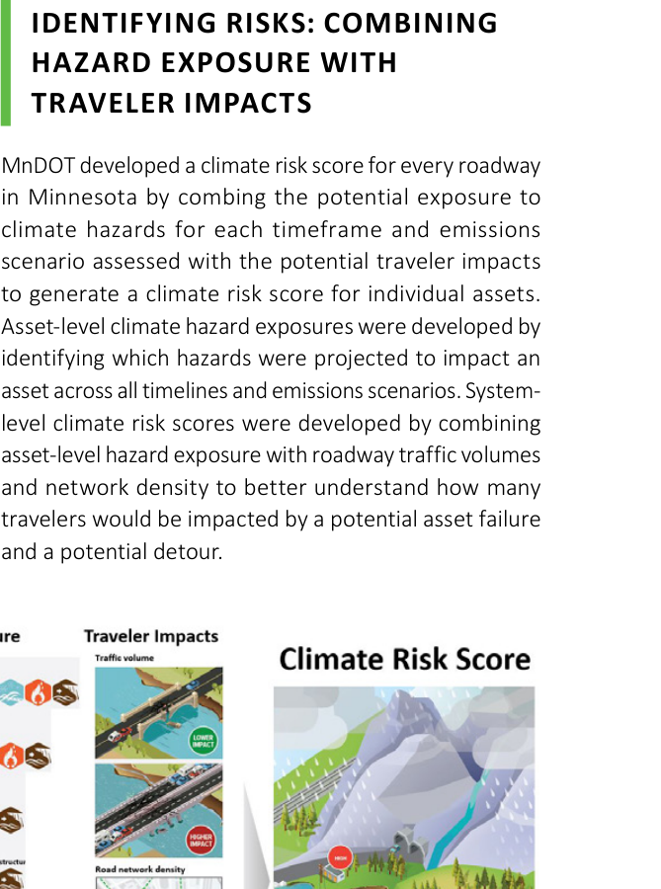
Minnesota / MnDOT: original definition and risk scoring
10/20 | MN_MnDOT_Resilience_Improvement_Plan_2024.pdf
Original PDF excerpt: definition
Verbatim resilience definition
RESILIENCE? There are immediate opportunities for MnDOT and partners to invest in climate resilience projects.
Definition source page: 35
Original PDF excerpt: risk scoring / assessment
Risk scoring / assessment
score/rating method: exposure
See original excerpt on the right for scoring table, matrix, or assessment language.
Source: MN_MnDOT_Resilience_Improvement_Plan_2024.pdf; definition p.35, risk p.29; URL: https://www.tam-portal.com/wp-content/uploads/sites/12/2025/07/2024-Resilience-Improvement-Plan-ADA-FINAL-38633998-v2.pdf

Slide 15
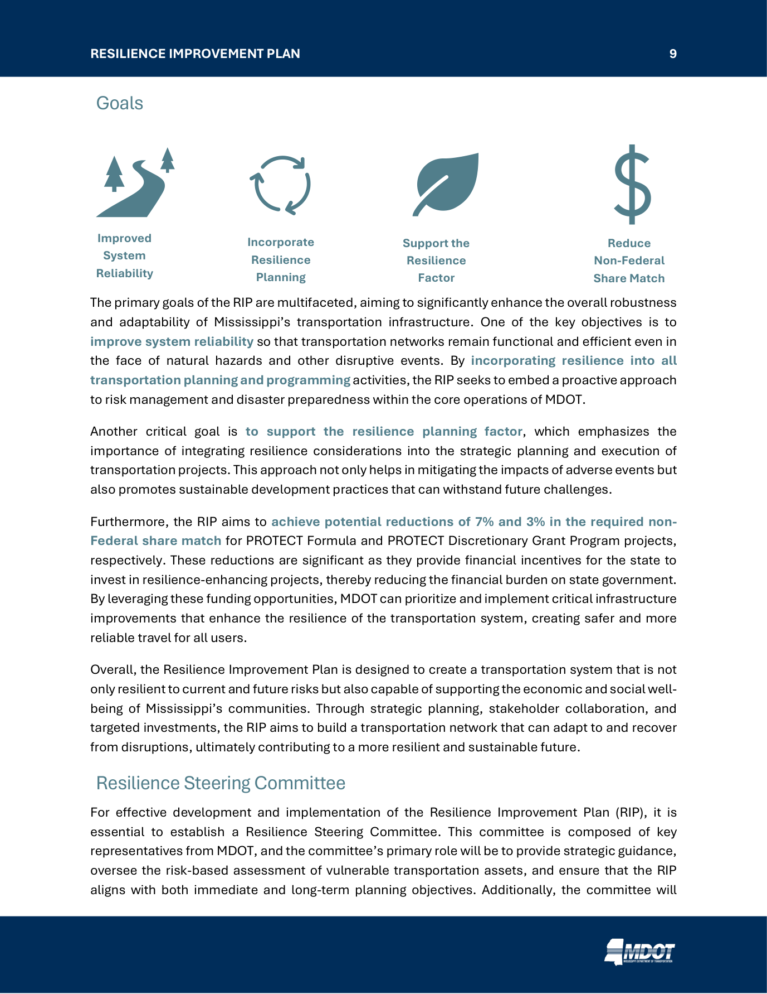
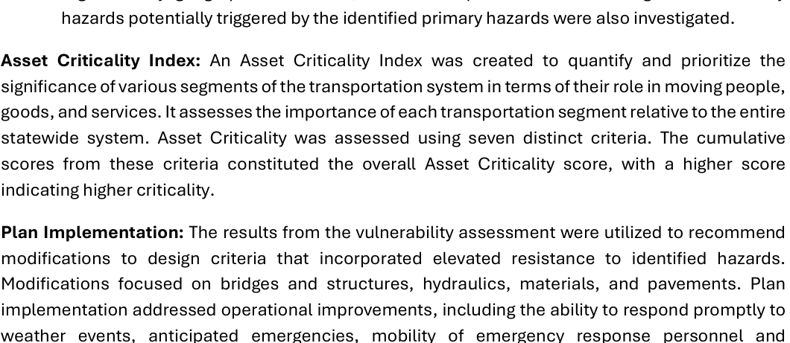
Mississippi / MDOT: original definition and risk scoring
11/20 | MS_MDOT_Resilience_Improvement_Plan.pdf
Original PDF excerpt: definition
Verbatim resilience definition
resilience-enhancing projects, thereby reducing the financial burden on state government.
Definition source page: 9
Original PDF excerpt: risk scoring / assessment
Risk scoring / assessment
score/rating method: criticality
See original excerpt on the right for scoring table, matrix, or assessment language.
Source: MS_MDOT_Resilience_Improvement_Plan.pdf; definition p.9, risk p.12; URL: https://mdot.ms.gov/documents/Planning/Resilience%20Planning/MDOT%20Resilience%20Improvement%20Plan.pdf

Slide 16
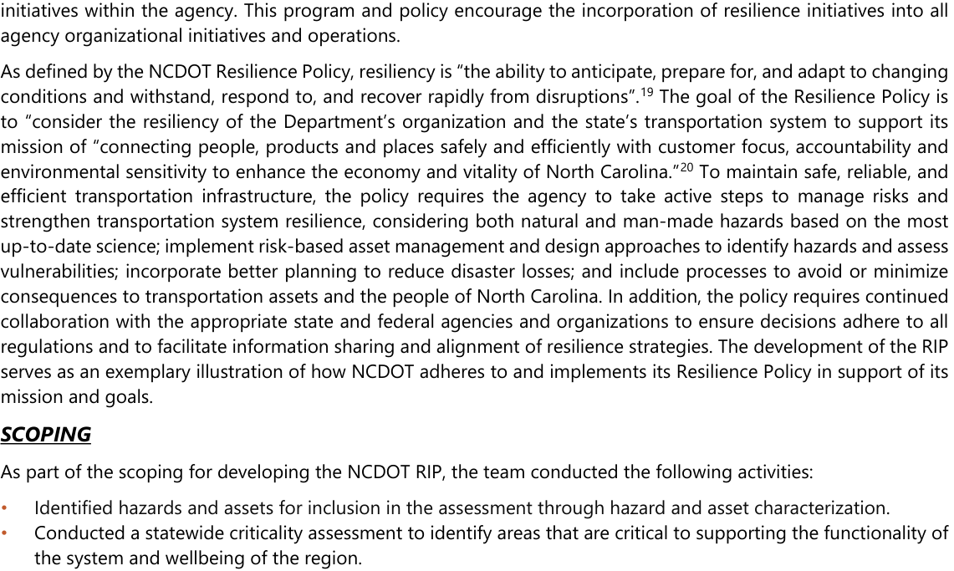
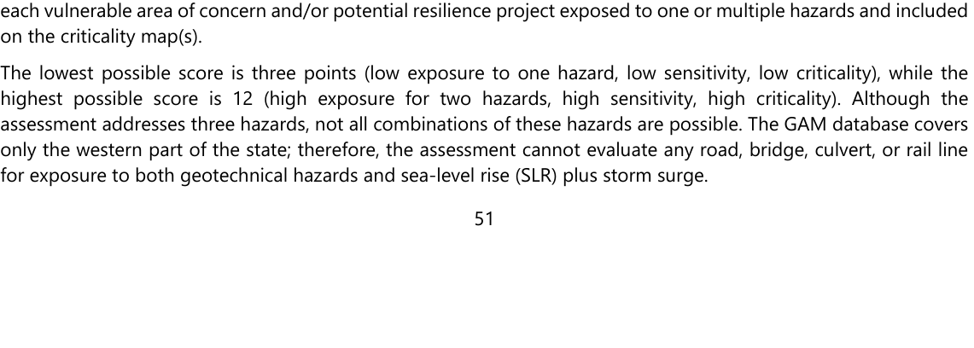
North Carolina / NCDOT: original definition and risk scoring
12/20 | NC_NCDOT_Resilience_Strategy_Report.pdf
Original PDF excerpt: definition
Verbatim resilience definition
resiliency is “the ability to anticipate, prepare for, and adapt to changing conditions and withstand, respond to, and recover rapidly from disruptions”.
Definition source page: 13
Original PDF excerpt: risk scoring / assessment
Risk scoring / assessment
score/rating method: exposure, sensitivity, criticality
See original excerpt on the right for scoring table, matrix, or assessment language.
Source: NC_NCDOT_Resilience_Strategy_Report.pdf; definition p.13, risk p.53; URL: https://www.ncdot.gov/initiatives-policies/Transportation/transportation-resilience/Documents/resilience-plan.pdf

Slide 17
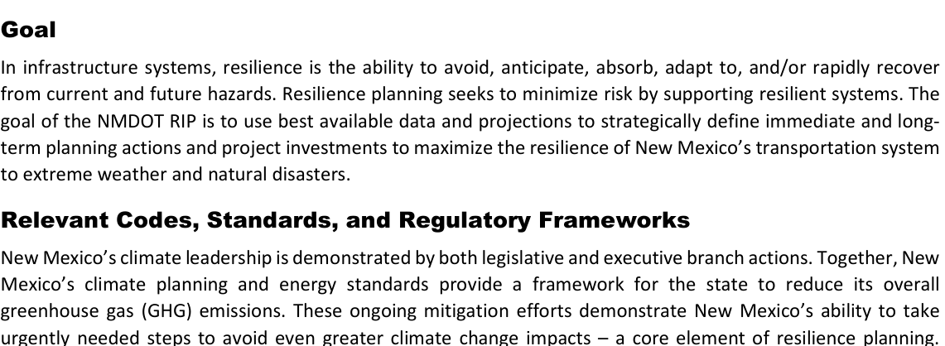
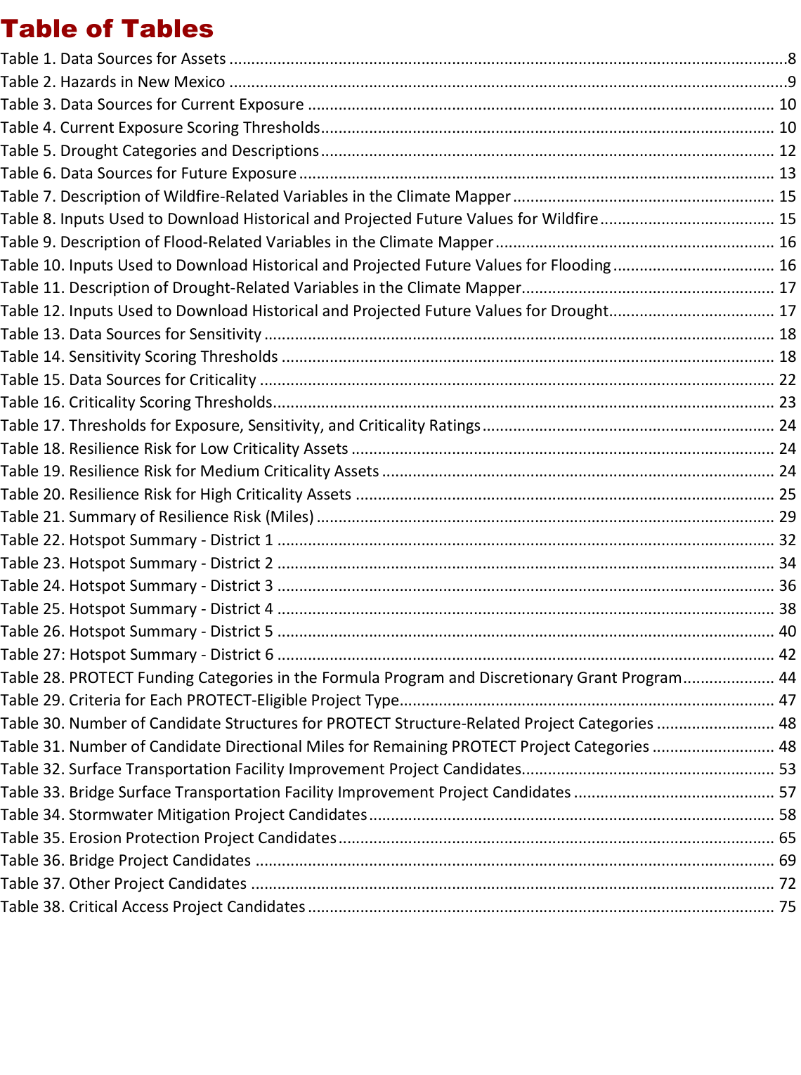
New Mexico / NMDOT: original definition and risk scoring
13/20 | NM_NMDOT_Resilience_Improvement_Plan_2024.pdf
Original PDF excerpt: definition
Verbatim resilience definition
resilience is the ability to avoid, anticipate, absorb, adapt to, and/or rapidly recover from current and future hazards.
Definition source page: 7
Original PDF excerpt: risk scoring / assessment
Risk scoring / assessment
score/rating method: exposure, sensitivity, criticality
See original excerpt on the right for scoring table, matrix, or assessment language.
Source: NM_NMDOT_Resilience_Improvement_Plan_2024.pdf; definition p.7, risk p.4; URL: https://www.erm-portal.com/wp-content/uploads/sites/15/2024/08/2024_0324_NMDOT-RIP_Final-3e0d72b101139cc6da2af69c7c26a4d5.pdf

Slide 18
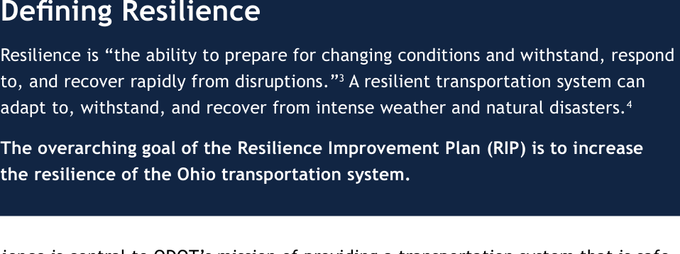
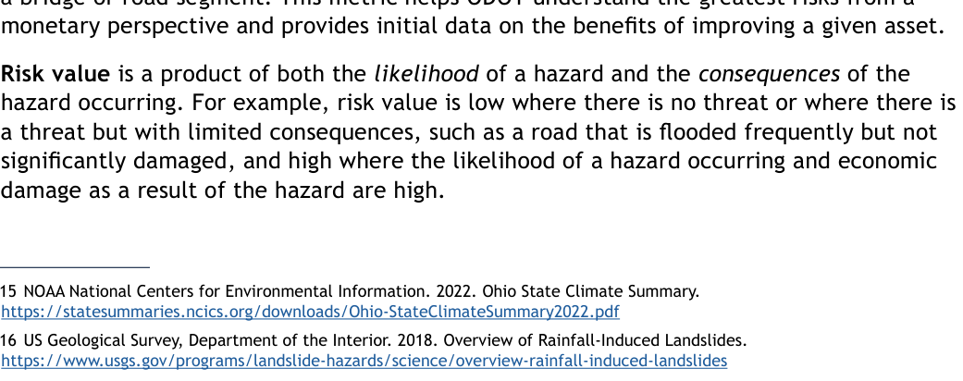
Ohio / ODOT: original definition and risk scoring
14/20 | OH_ODOT_Resilience_Improvement_Plan.pdf
Original PDF excerpt: definition
Verbatim resilience definition
Resilience is central to ODOT’s mission of providing a transportation system that is safe, accessible, well maintained, and positioned for the future.
Definition source page: 5
Original PDF excerpt: risk scoring / assessment
Risk scoring / assessment
risk-based vulnerability assessment: likelihood, consequence/severity
See original excerpt on the right for scoring table, matrix, or assessment language.
Source: OH_ODOT_Resilience_Improvement_Plan.pdf; definition p.5, risk p.15; URL: https://dam.assets.ohio.gov/image/upload/transportation.ohio.gov/statewide-planning/resilience/Resilience-Improvement-Plan.pdf

Slide 19
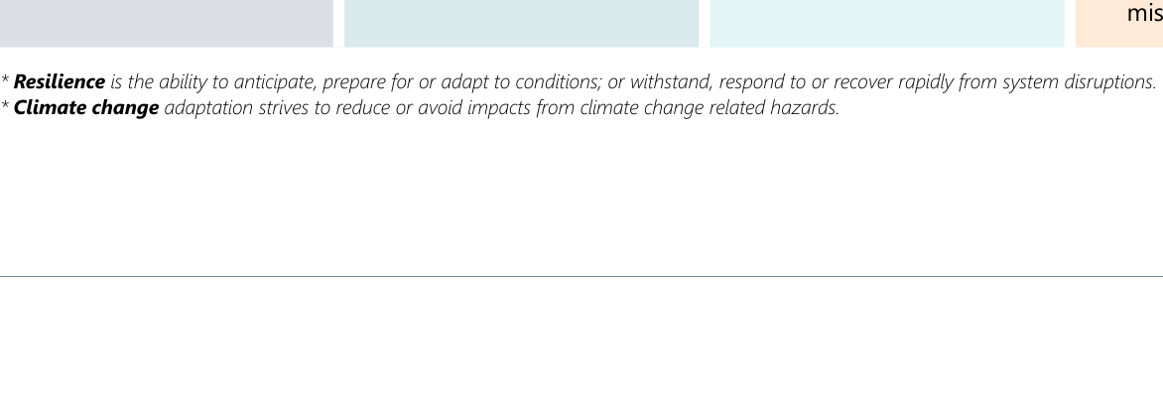
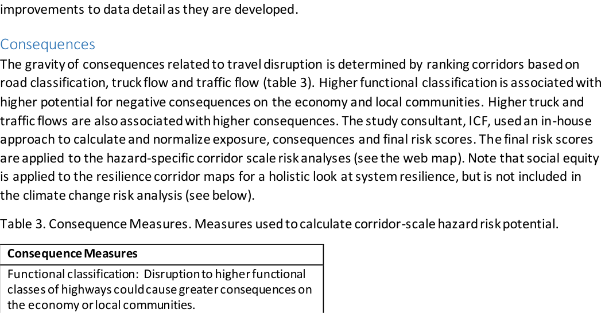
Oregon / ODOT: original definition and risk scoring
15/20 | OR_ODOT_Climate_Adaptation_Resilience_Roadmap.pdf
Original PDF excerpt: definition
Verbatim resilience definition
Resilience is the ability to anticipate, prepare for or adapt to conditions; or withstand, respond to or recover rapidly from system disruptions.
Definition source page: 46
Original PDF excerpt: risk scoring / assessment
Risk scoring / assessment
score/rating method: consequence/severity, exposure
See original excerpt on the right for scoring table, matrix, or assessment language.
Source: OR_ODOT_Climate_Adaptation_Resilience_Roadmap.pdf; definition p.46, risk p.78; URL: https://www.tam-portal.com/wp-content/uploads/sites/12/2025/01/ClimateAdaptation_andResilienceRoadmap.pdf

Slide 20
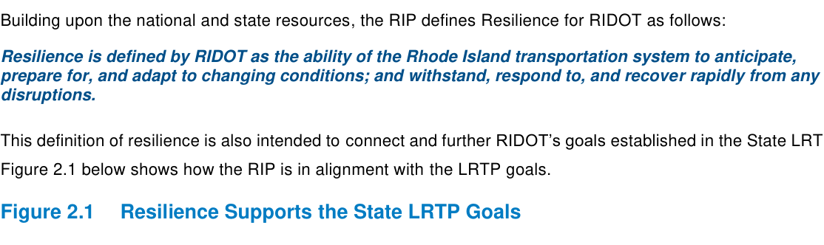
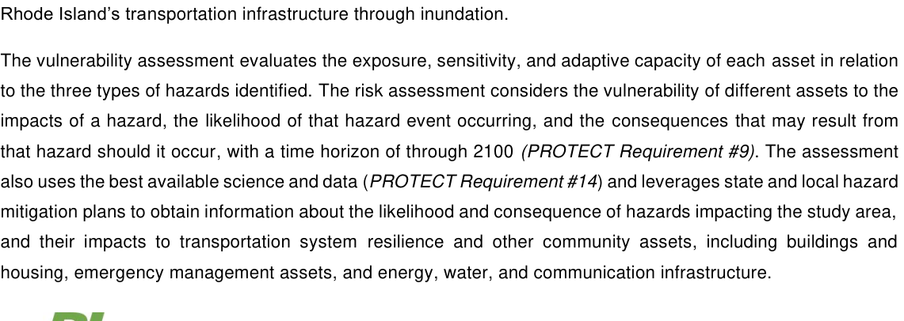
Rhode Island / RIDOT: original definition and risk scoring
16/20 | RI_RIDOT_Approved_RIP.pdf
Original PDF excerpt: definition
Verbatim resilience definition
Resilience is defined by RIDOT as the ability of the Rhode Island transportation system to anticipate, prepare for, and adapt to changing conditions; and withstand, respond to, and recover rapidly from any disruptions.
Definition source page: 27
Original PDF excerpt: risk scoring / assessment
Risk scoring / assessment
risk-based vulnerability assessment: exposure, sensitivity, adaptive capacity, vulnerability
See original excerpt on the right for scoring table, matrix, or assessment language.
Source: RI_RIDOT_Approved_RIP.pdf; definition p.27, risk p.22; URL: https://www.dot.ri.gov/rhodeworks/docs/RIDOT_Approved_RIP.pdf

Slide 21
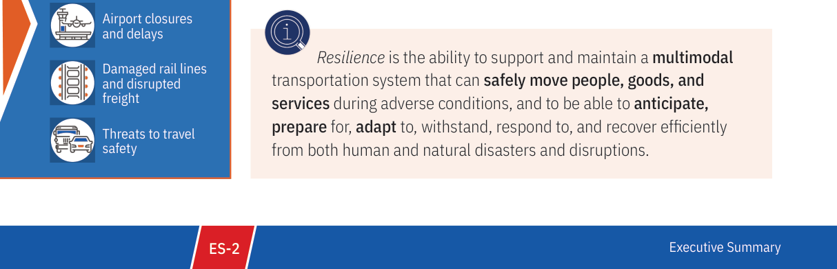
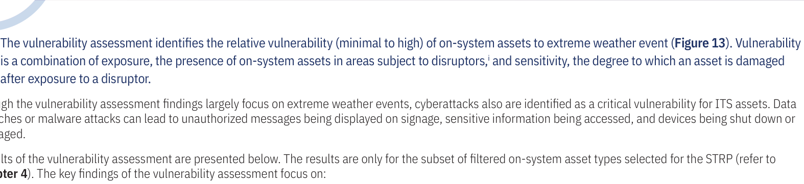
Texas / TxDOT: original definition and risk scoring
17/20 | TX_TxDOT_Statewide_Transportation_Resilience_Plan_2025.pdf
Original PDF excerpt: definition
Verbatim resilience definition
Resilience is the ability to support and maintain a multimodal transportation system that can safely move people, goods, and services during adverse conditions, and to be able to anticipate, prepare for, adapt to, withstand, respond to, and recover efficiently from both human and natural disasters and disruptions.
Definition source page: 6
Original PDF excerpt: risk scoring / assessment
Risk scoring / assessment
risk-based vulnerability assessment: exposure, sensitivity, vulnerability
See original excerpt on the right for scoring table, matrix, or assessment language.
Source: TX_TxDOT_Statewide_Transportation_Resilience_Plan_2025.pdf; definition p.6, risk p.57; URL: https://www.txdot.gov/content/dam/docs/division/tpp/2025-statewide-resiliency-plan.pdf

Slide 22
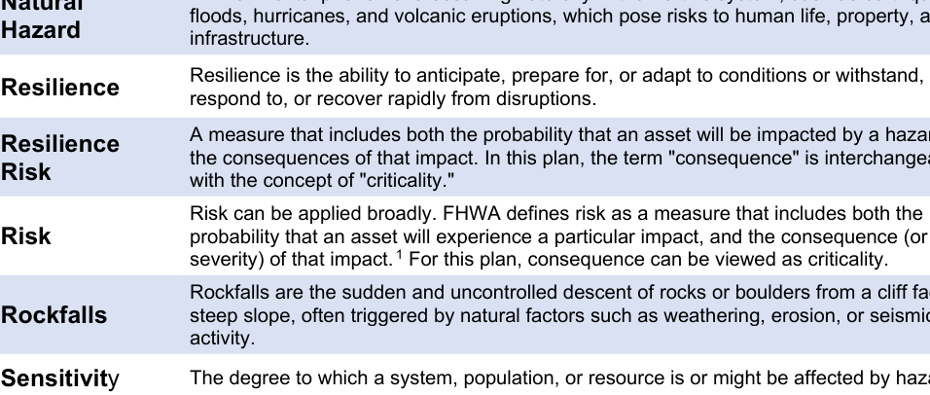
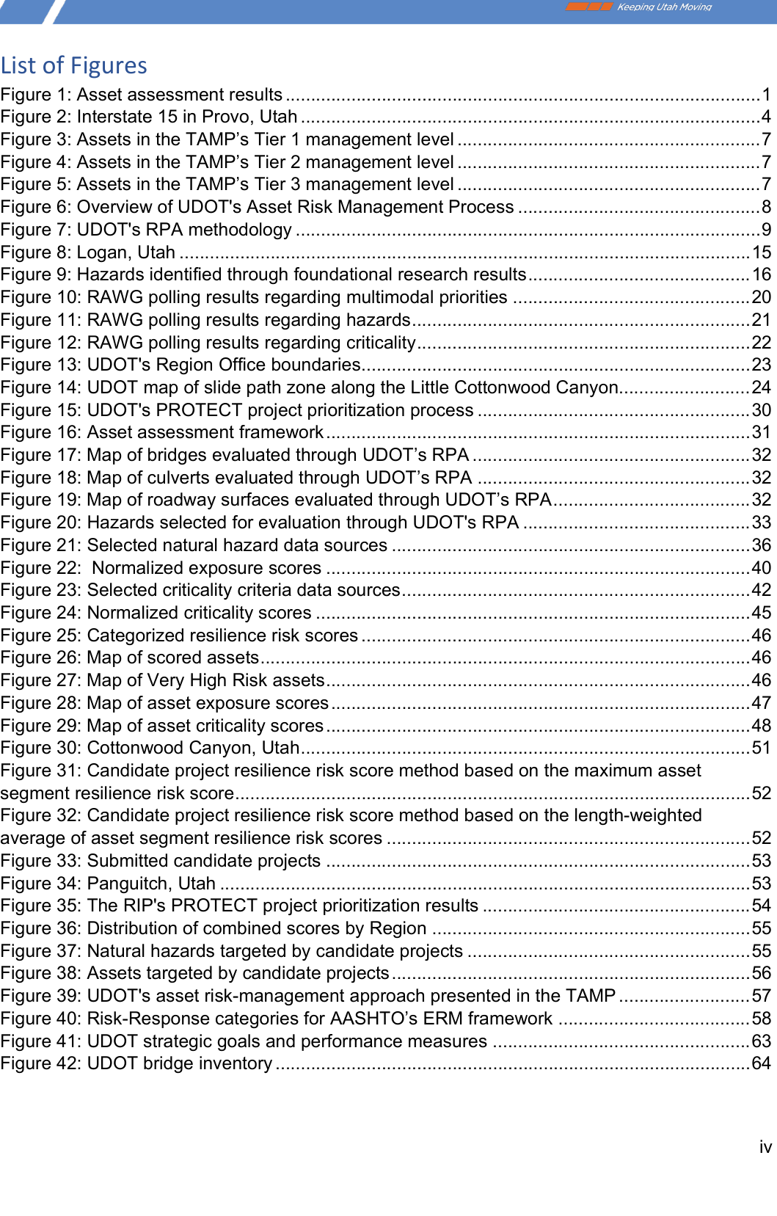
Utah / UDOT: original definition and risk scoring
18/20 | UT_UDOT_Resilience_Improvement_Plan_2024.pdf
Original PDF excerpt: definition
Verbatim resilience definition
Resilience is the ability to anticipate, prepare for, or adapt to conditions or withstand, respond to, or recover rapidly from disruptions.
Definition source page: 6
Original PDF excerpt: risk scoring / assessment
Risk scoring / assessment
score/rating method: exposure, criticality
See original excerpt on the right for scoring table, matrix, or assessment language.
Source: UT_UDOT_Resilience_Improvement_Plan_2024.pdf; definition p.6, risk p.4; URL: https://www.erm-portal.com/wp-content/uploads/sites/15/2024/09/2024-05-07-FINAL-UDOT-RIP-eee071ab388ba424f01311f4404fd110.pdf

Slide 23
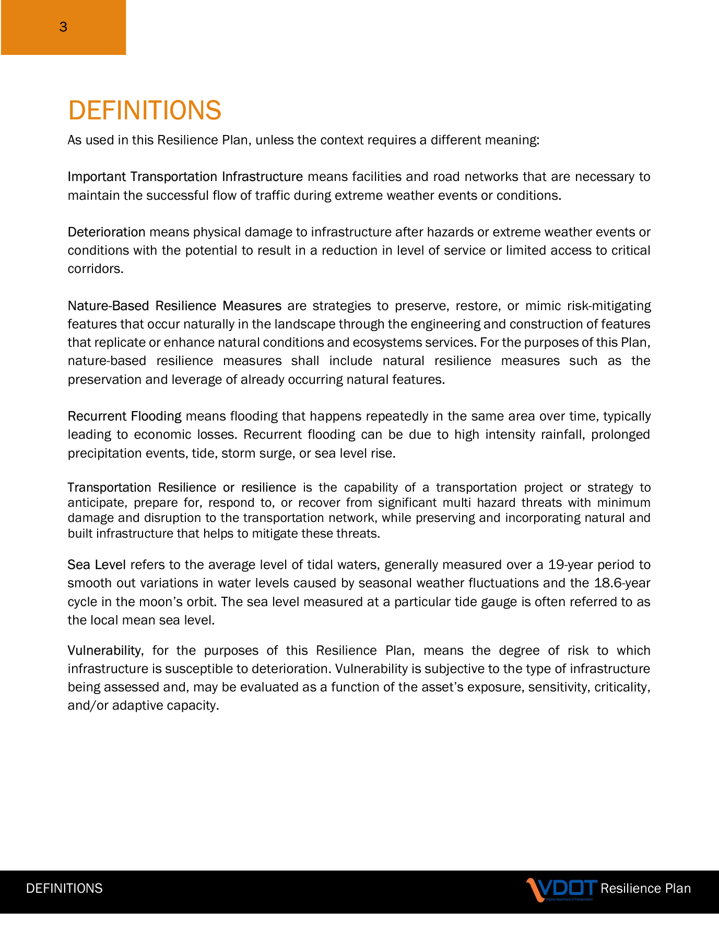
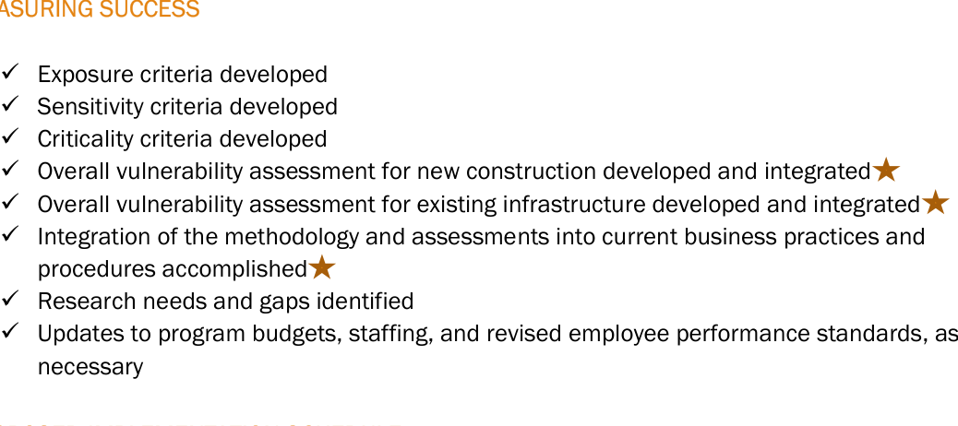
Virginia / VDOT: original definition and risk scoring
19/20 | VA_VDOT_Resilience_Plan_2022.pdf
Original PDF excerpt: definition
Verbatim resilience definition
resilience is the capability of a transportation project or strategy to anticipate, prepare for, respond to, or recover from significant multi hazard threats with minimum damage and disruption to the transportation network, while preserving and incorporating natural and built infrastructure that helps to mitigate these threats.
Definition source page: 6
Original PDF excerpt: risk scoring / assessment
Risk scoring / assessment
risk-based vulnerability assessment: exposure, sensitivity, criticality, vulnerability
See original excerpt on the right for scoring table, matrix, or assessment language.
Source: VA_VDOT_Resilience_Plan_2022.pdf; definition p.6, risk p.26; URL: https://www.erm-portal.com/wp-content/uploads/sites/15/2023/03/VDOT-Resilience-Plan_Nov_2022_FINAL-92cd22fca3674bdb5af0a3eb49a7e62d.pdf

Slide 24
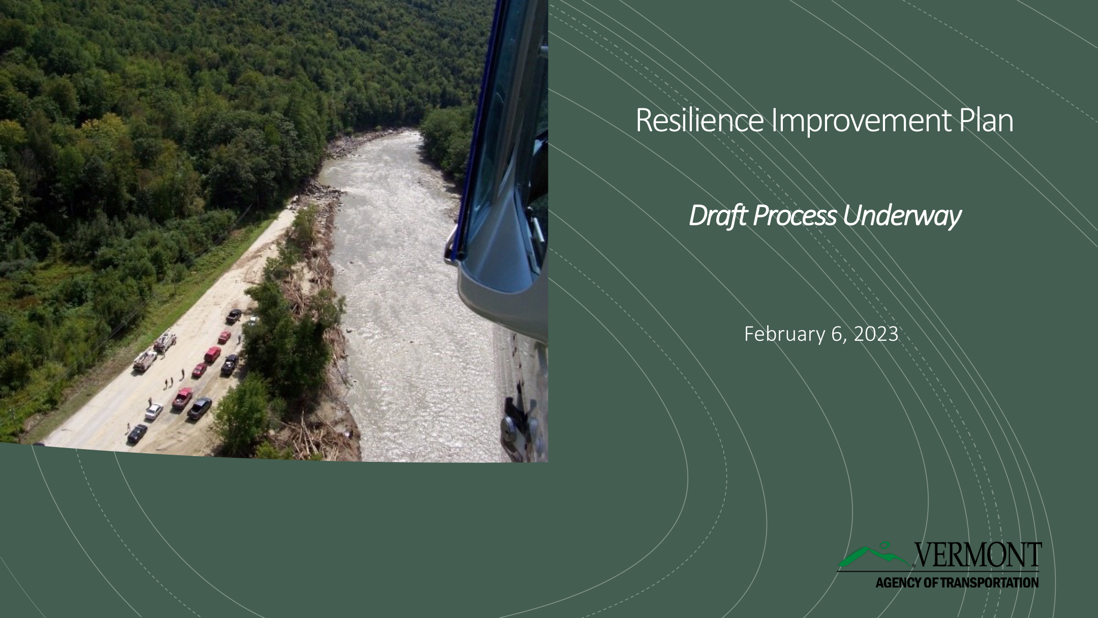
Vermont / VTrans: original definition and risk scoring
20/20 | VT_VTrans_RIP_Process_2023.pdf
Original PDF excerpt: definition
Verbatim resilience definition
No formal resilience definition found in the downloaded PDF.
Definition source page: 1
Original PDF excerpt: risk scoring / assessment
Risk scoring / assessment
risk-based vulnerability assessment: no explicit scoring formula found in the located excerpt
See original excerpt on the right for scoring table, matrix, or assessment language.
Source: VT_VTrans_RIP_Process_2023.pdf; definition p.1, risk p.1; URL: https://www.erm-portal.com/wp-content/uploads/sites/15/2023/03/2023-03-06-Vermont-RIP-Process-to-FHWA-VT-d6f8550d06fc4be24e33ab32ad4da7bd-1.pdf

Slide 25
Source Appendix
Downloaded PDFs used in the deck.
CA
CA_Caltrans_SCRIPT_RIP_2023_Amendment1.pdf
https://dot.ca.gov/-/media/dot-media/programs/transportation-planning/documents/office-of-smart-mobility-and-climate-change/2023-script-amendment
CO
CO_CDOT_Resilience_Improvement_Plan.pdf
https://www.tam-portal.com/wp-content/uploads/sites/12/2025/07/cdot-resilience-improvement-plan-final-02-10-2025.pdf
CT
CT_CTDOT_Resilience_Improvement_Plan.pdf
https://portal.ct.gov/dot/-/media/dot/programs/rip/ctdot-resilience-improvement-plan.pdf
DE
DE_DelDOT_DRIP_FHWA_Approved_2023.pdf
https://www.erm-portal.com/wp-content/uploads/sites/15/wpforms/7075-e1233af55e4247e91b2324b29a729bf8/DelDOT-DRIP-FHWA-Approved-09.07.23-a120b9904
FL
FL_FDOT_RIP_CEP_Final.pdf
https://fdotwww.blob.core.windows.net/sitefinity/docs/default-source/planning/resilience-(opp)/resilience-improvement-plan/rip_cep_final.pdf?sfvr
IA
IA_IowaDOT_2024_Resilience_Improvement_Plan.pdf
https://iowadot.gov/media/2596/download?inline=
KY
KY_KYTC_Resiliency_Improvement_Plan_2023.pdf
https://www.erm-portal.com/wp-content/uploads/sites/15/2024/08/KYTC-Resiliency-Improvement-Plan-202306-bfe355f2a24c9e7591e4146a5b7226e1.pdf
MD
MD_MDOT_Transportation_Resilience_Improvement_Plan_2024.pdf
https://www.mdot.maryland.gov/OPCP/MDOT_TRIP_Report_2024_Final.pdf
MI
MI_MDOT_Resilience_Improvement_Plan_2024.pdf
https://www.michigan.gov/mdot/-/media/Project/Websites/MDOT/Programs/Planning/Resilience-Improvement-Plan/Plan.pdf
MN
MN_MnDOT_Resilience_Improvement_Plan_2024.pdf
https://www.tam-portal.com/wp-content/uploads/sites/12/2025/07/2024-Resilience-Improvement-Plan-ADA-FINAL-38633998-v2.pdf
MS
MS_MDOT_Resilience_Improvement_Plan.pdf
https://mdot.ms.gov/documents/Planning/Resilience%20Planning/MDOT%20Resilience%20Improvement%20Plan.pdf
NC
NC_NCDOT_Resilience_Strategy_Report.pdf
https://www.ncdot.gov/initiatives-policies/Transportation/transportation-resilience/Documents/resilience-plan.pdf
NM
NM_NMDOT_Resilience_Improvement_Plan_2024.pdf
https://www.erm-portal.com/wp-content/uploads/sites/15/2024/08/2024_0324_NMDOT-RIP_Final-3e0d72b101139cc6da2af69c7c26a4d5.pdf
OH
OH_ODOT_Resilience_Improvement_Plan.pdf
https://dam.assets.ohio.gov/image/upload/transportation.ohio.gov/statewide-planning/resilience/Resilience-Improvement-Plan.pdf
OR
OR_ODOT_Climate_Adaptation_Resilience_Roadmap.pdf
https://www.tam-portal.com/wp-content/uploads/sites/12/2025/01/ClimateAdaptation_andResilienceRoadmap.pdf
RI
RI_RIDOT_Approved_RIP.pdf
https://www.dot.ri.gov/rhodeworks/docs/RIDOT_Approved_RIP.pdf
TX
TX_TxDOT_Statewide_Transportation_Resilience_Plan_2025.pdf
https://www.txdot.gov/content/dam/docs/division/tpp/2025-statewide-resiliency-plan.pdf
UT
UT_UDOT_Resilience_Improvement_Plan_2024.pdf
https://www.erm-portal.com/wp-content/uploads/sites/15/2024/09/2024-05-07-FINAL-UDOT-RIP-eee071ab388ba424f01311f4404fd110.pdf
VA
VA_VDOT_Resilience_Plan_2022.pdf
https://www.erm-portal.com/wp-content/uploads/sites/15/2023/03/VDOT-Resilience-Plan_Nov_2022_FINAL-92cd22fca3674bdb5af0a3eb49a7e62d.pdf

Slide 26
Source Appendix
Continued
VT
VT_VTrans_RIP_Process_2023.pdf
https://www.erm-portal.com/wp-content/uploads/sites/15/2023/03/2023-03-06-Vermont-RIP-Process-to-FHWA-VT-d6f8550d06fc4be24e33ab32ad4da7bd-1.pdf

